Slide 1

DIABETES PREDICTION SYSTEM
ARTIFICAL INTELLIGENCE

Slide 2
ABSTRACT
Globally, diabetes affects 537 million people, making it the deadliest and the most common non‐communicable disease. Many factors can cause a person to get affected by diabetes, like excessive body weight, abnormal cholesterol level, family history, physical inactivity, bad food habit etc. Increased urination is one of the most common symptoms of this disease. People with diabetes for a long time can get several complications like heart disorder, kidney disease, nerve damage, diabetic retinopathy etc. But its risk can be reduced if it is predicted early.
In this project, an automatic diabetes prediction system has been developed using a dataset and various machine learning techniques. A semi‐supervised model with extreme gradient boosting has been utilized to predict the insulin features of the dataset. SMOTE and ADASYN approaches have been employed to manage the class imbalance problem. We use machine learning classification methods, i.e., decision tree, SVM, Random Forest, Logistic Regression, KNN, and various ensemble techniques, to determine which algorithm produces the best prediction results. Furthermore, the domain adaptation method has been implemented to demonstrate the versatility of the proposed system. The explainable AI approach with LIME and SHAP frameworks is implemented to understand how the model predicts the final results.

Slide 3
INTRODUCTION
Diabetes is a chronic disease that directly affects the pancreas, and the body is incapable of producing insulin . Insulin is mainly responsible for maintaining the blood glucose level. Many factors, such as excessive body weight, physical inactivity, high blood pressure, and abnormal cholesterol level, can cause a person get affected by diabetes . It can cause many complications, but an increase in urination is one of the most common ones . It can damage the skin, nerves, and eyes, and if not treated early, diabetes can cause kidney failure and diabetic retinopathy ocular disease. According to IDF (International Diabetes Federation) statistics, 537 million people had diabetes around the world in 2021.
Early and accurate diagnosis of diabetes mellitus, especially during its initial development, is challenging for medical professionals. Artificial intelligence and machine learning techniques, providing a reference, can help them gain preliminary knowledge about this disease and reduce their workload accordingly.
For predicting blood pressure status, they used conditional decision making and for predicting diabetes, they used SVM, KNN, and decision tree. Among these models, SVM worked better as they got 75% accuracy which is better than other classifier algorithms.

Slide 4
PROBLEM STATEMENT
Develop an AI-powered diabetes prediction system that leverages machine learning algorithms to analyze medical data and predict the likelihood of an individual developing diabetes, providing early risk assessment and personalized preventive measures.

Slide 5
PROBLEM DEFINITION
The problem is to build an AI-powered diabetes prediction system that uses machine learning algorithms to analyze medical data and predict the likelihood of an individual developing diabetes. The system aims to provide early risk assessment and personalized preventive measures, allowing individuals to take proactive actions to manage their health.

Slide 6
DESING THINKING
To address this problem, we will follow a systematic approach involving the following key steps:
1. Data Collection
2. Data Preprocessing
3. Feature Selection
4. Model Selection
5. Evaluation
6. Iterative Improvement

Slide 7
DATA COLLECTION
In this stage, we use the data from the given data set provided through the Kaggle software.
Ensure the dataset is representative of the real-world scenarios of diabetes patients.
The data set provided makes it easier for data preprocessing.

Slide 8
DATA PREPROCESSING
Clean the data to prepare it for predicting. This involves several steps:
Handling Missing Data: Deal with missing values, if any, through imputation or removal.
Removing Duplicates: Eliminate the duplicate data to prevent error in the prediction.

Slide 9
FEATURE SELECTION
Based on the following features from the given data set, we predict the diabetes positive patients:
1. Glucose level
2. Blood pressure
3. Insulin
4. Age
5. Skin Thickness
6. BMI
7. Diabetes Pedigree Function
8. Pregnancies

Slide 10
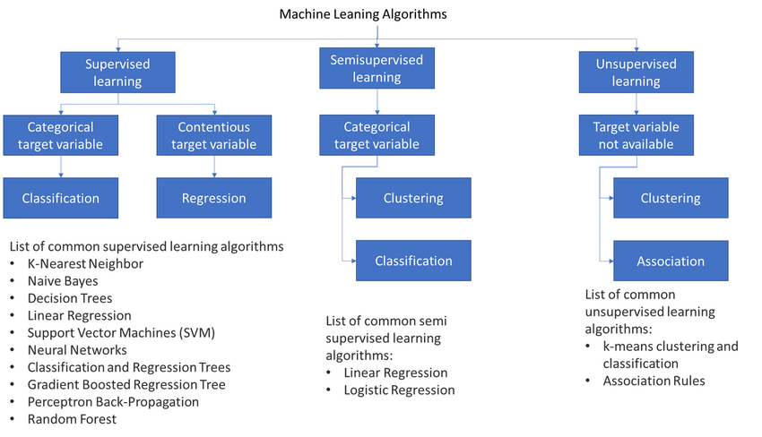
MODEL SELECTION

Slide 11
EVALUTION
Performance Metrics: We will evaluate the model's performance using various metrics, including:
1. Accuracy: To measure the overall correctness of the classification.
2. Precision: To assess the model's ability to correctly classify the given data set.
3. Recall: To measure the model's capacity to correctly identify the given data set.

Slide 12
ITERATIVE IMPROVEMENT
The improve the accuracy of the diabetes prediction using feedback loops, Ethical Considerations, Deployment and Monitoring, Interpretability and Explainability, Regularization, Ensemble Methods, Iterate and Refine, Performance Metrics, Validation and Cross-Validation, Hyperparameter Tuning, Model Selection, Feature Engineering, Data Collection and Preprocessing.

Slide 13
CONCLUSION
Diabetes can be a reason for reducing life expectancy and quality. Predicting this chronic disorder earlier can reduce the risk and complications of many diseases in the long run. In this paper, an automatic diabetes prediction system using various machine learning approaches has been proposed.
There are some future scopes of this work, for example, we recommend getting additional private data with a larger cohort of patients to get better results. Another extension of this work is combining machine learning models with fuzzy logic techniques and applying optimization approaches.

